Slide 1
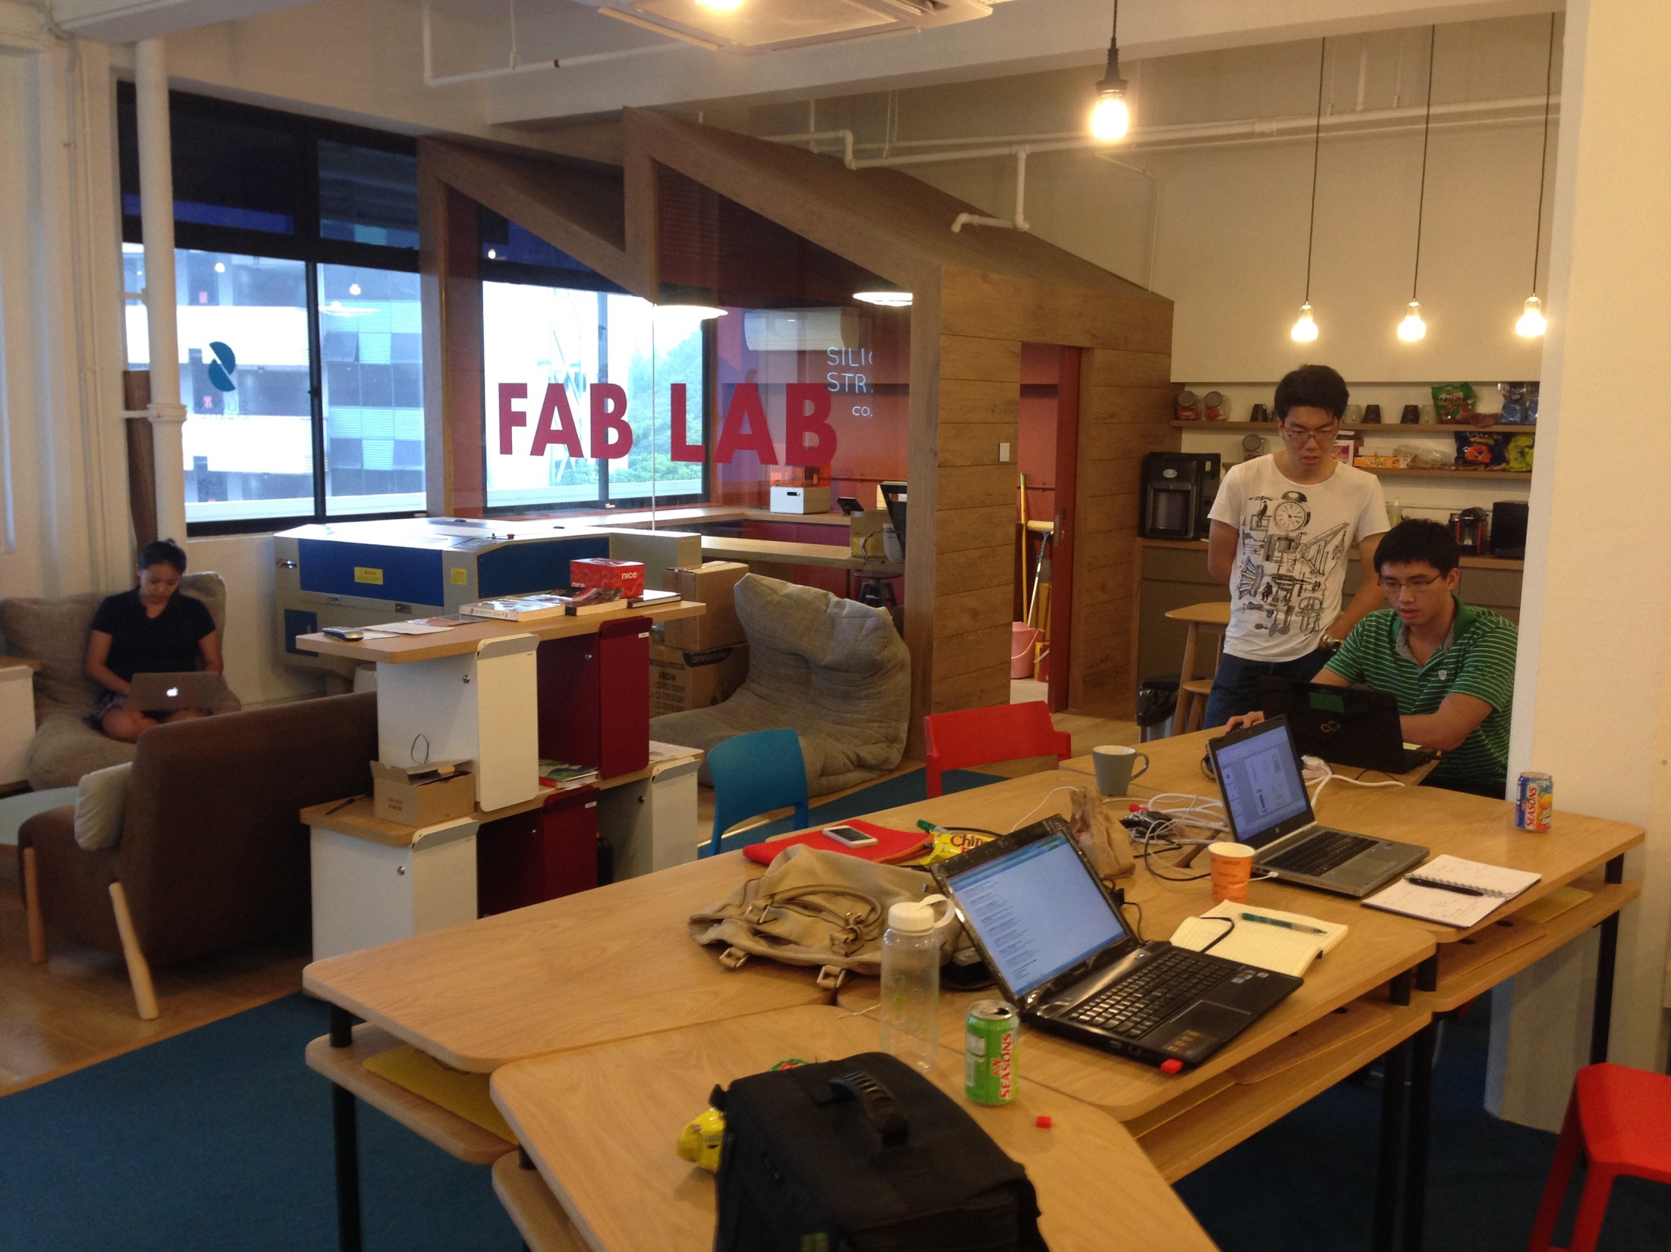

Slide 2
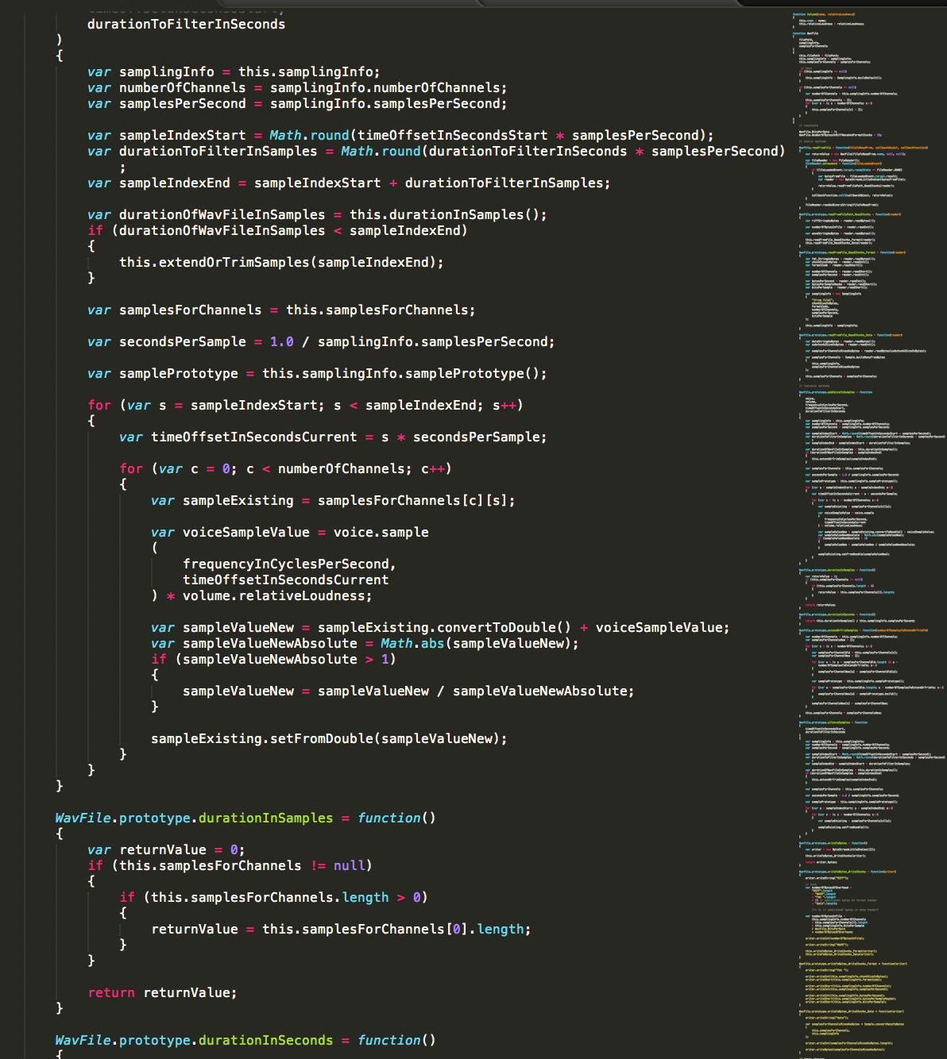

Slide 3
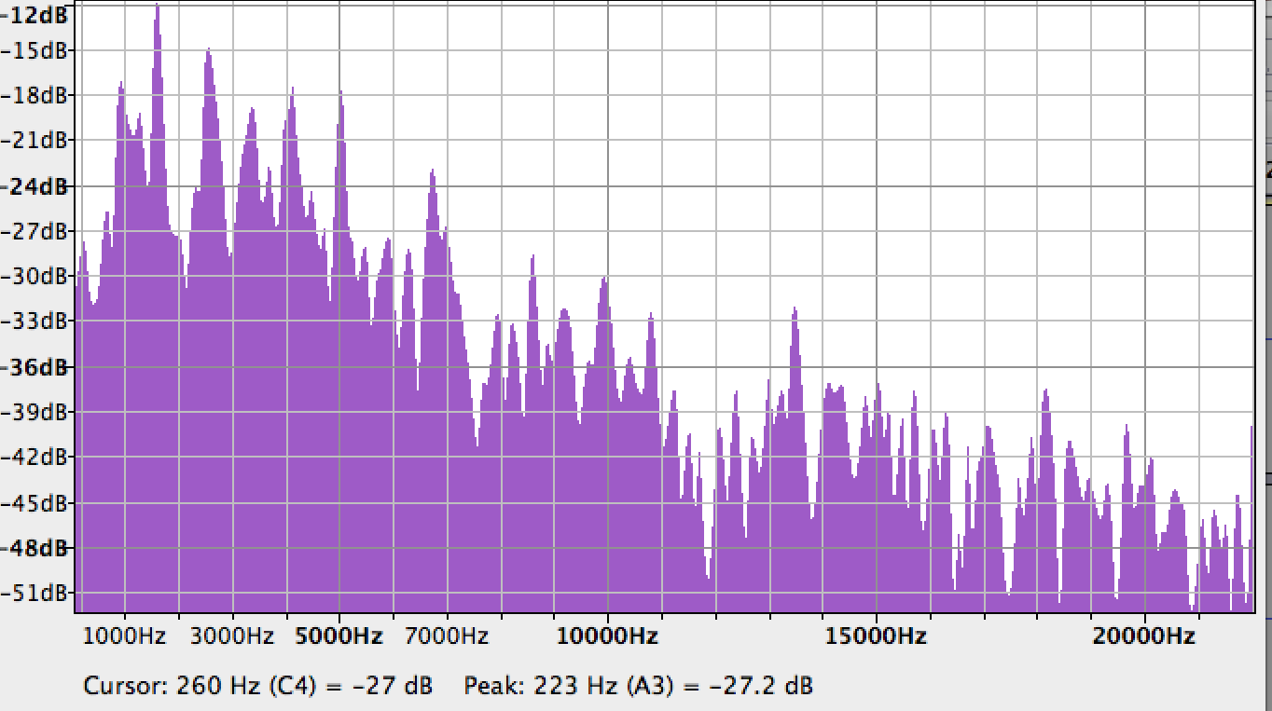

Slide 4
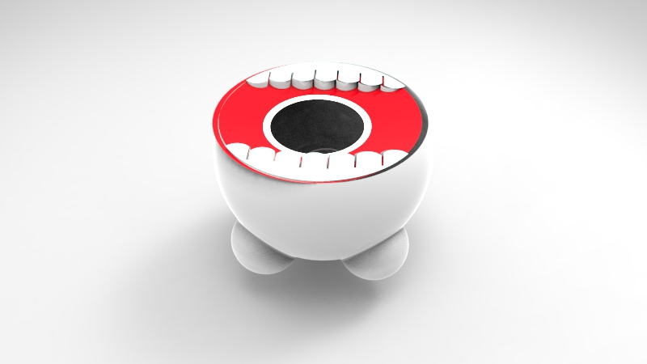
Notes:
Different materials emit different sounds
Our recycling monster will be fitted with sound sensors to detect these sounds, and feedback to the user when the right or wrong object has been thrown.
Blue light for right recycling material
Red light for wrong recycling material
This feedback mechanism rewards and slightly embarrass the user all in good fun, to educate them on the right habits
This does not end here
The user will then be directed to a QR code where they are encouraged to scan.

Slide 5
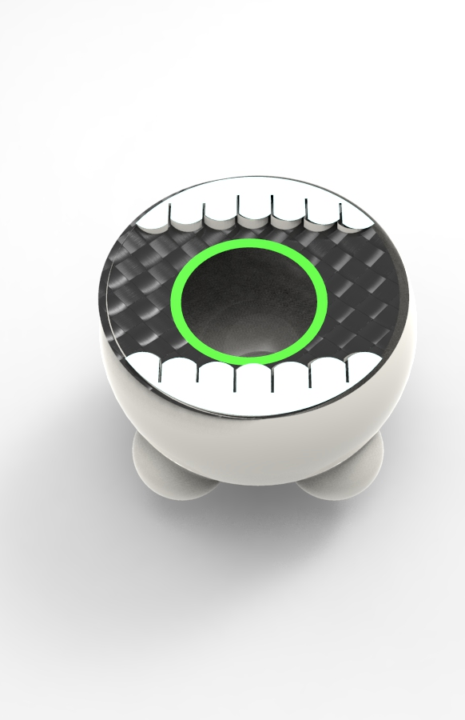
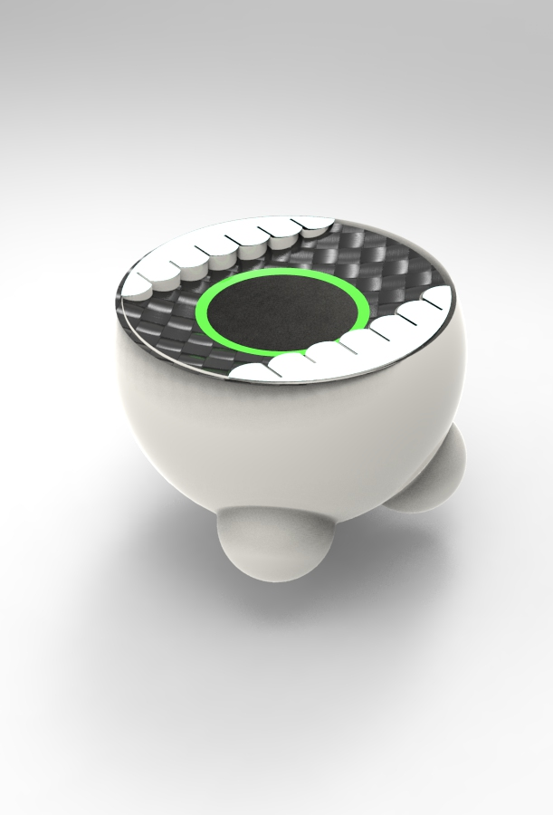

Slide 6
